Slide 1
Inflation

Slide 2
Inflation
In economics, inflation is a rise in the general level of prices of goods and services in an economy over a period of time. When the general price level rises, each unit of currency buys fewer goods and services.

Slide 3
Definitions of inflation
According to Webster's “An increase in the amount of currency in circulation, resulting in a relatively sharp and sudden fall in its value and rise in prices: it may be caused by an increase in the volume of paper money issued, or a relative increase in expenditures as when the supply of goods fails to meet the demand”.
According to Prof. Samuelson “inflation occurs when general level of prices & cost are rising”.

Slide 4
Causes of inflation
Demand-pull inflation
Cost-push inflation

Slide 5
DEMAND-PULL INFLATION
Any inflation that results from an increase in demand is called demand-pull inflation
Caused by
Increased Incomes
Decreased income taxes
Decreased tendency to save
Consumers expect prices to rise in the future
More money in the economy

Slide 6
COST-PUSH INFLATION
Any inflation that results from a decrease in supply is called cost-push inflation.
Caused by
Increased costs of raw materials
Increased Wages
Failure to replace capital goods as they age, reducing its productivity, or increasing its maintenance costs
Falling Productivity of workers

Slide 7
Measuring Inflation
Producer Price Index
The PPI measures the average change in the sale prices for the entire domestic market of raw goods and services.
These goods and services are bought by consumers from their primary producers, bought indirectly from retail sellers and purchased by producers themselves.
The PPI comprises prices of both capital equipment and consumer goods.
The industries that compile the PPI include mining, manufacturing, agriculture, fishing, forestry, natural gas, electricity, construction, waste and scrap materials.
Sales and excise taxes are not taken into account while determining PPI.

Slide 8
The Consumer Price Index
Economists have developed a measure called the consumer price index (CPI),
Which is based on a typical market basket of goods and services required by the average consumer.
This market basket usually consists of items from eight major group
Food and beverages
Housing
Apparel
Transportation
Medical care
Entertainment
Personal care
Other goods and services

Slide 9
The Consumer Price Index
Constructing the CPI
Constructing the CPI involves three stages:
Selecting the CPI basket
Conducting a monthly price survey
Using the prices and the basket to calculate the CPI

Slide 10
The Consumer Price Index
For a simple economy that consumes only oranges and haircuts, we can calculate the CPI.
The CPI basket is 10 oranges and 5 haircuts.
Item | Quantity | Price | Cost of CPI basket
Oranges | 10 | $1.00 | $10
Haircuts | 5 | $8.00 | $40
Cost of CPI basket at base period prices |  |  | $50

Slide 11
The Consumer Price Index
This table shows the prices in the base period.
The cost of the CPI basket in the base period was $50.
Item | Quantity | Price | Cost of CPI basket
Oranges | 10 | $1.00 | $10
Haircuts | 5 | $8.00 | $40
Cost of CPI basket at base period prices |  |  | $50

Slide 12
The Consumer Price Index
This table shows the prices in the current period.
The cost of the CPI basket in the current period is $70.
Item | Quantity | Price | Cost of CPI basket
Oranges | 10 | $2.00 | $20
Haircuts | 5 | $10.00 | $50
Cost of CPI basket at current period prices |  |  | $70

Slide 13
The Consumer Price Index
The CPI is calculated using the formula:
CPI = (Cost of basket in current period/Cost of basket in base period)  100.
Using the numbers for the simple example, the CPI is
CPI = ($70/$50)  100 = 140.
The CPI is 40 percent higher in the current period than in the base period.

Slide 14
The Consumer Price Index
Measuring Inflation
The main purpose of the CPI is to measure inflation.
The inflation rate is the percentage change in the price level from one year to the next.
The inflation formula is:
Inflation rate = [(CPI this year – CPI last year)/CPI last year] × 100.

Slide 15
Example

Slide 16
Difference between PPI and CPI
The first difference between the indexes is the targeted goods and services. The producer price index focuses on the whole output of producers. This index is very broad, including not only the goods and services purchased by producers as inputs in their own operations or as investment, but also includes goods and services bought by consumers from retail sellers and directly from the producer.
In contrast, the consumer price index targets goods and services that are bought for consumption by urban residents. The CPI includes imports; the PPI does not.
The second fundamental difference between the indexes includes the prices. In the producer price index, taxes are not included for the producer's returns.
Conversely, the consumer price index includes taxes because these factors do directly impact the consumer by having to pay more for the goods and services.

Slide 17
Controlling inflation
There are broadly two ways of controlling inflation in an economy:
1). Monetary measures
2). Fiscal measures
Monetary Measures
The most important and commonly used method to control inflation is monetary policy of the Central Bank. Most central banks use high interest rates as the traditional way to fight or prevent inflation.

Slide 18
Monetary measures used to control inflation include:
(i) Bank rate policy
(ii) CRR
(iii) Open market operations

Slide 19
Fiscal measures to control inflation include:
(i)Increase in Taxes
(ii) Increase in savings
(iii) surplus budgets

Slide 20
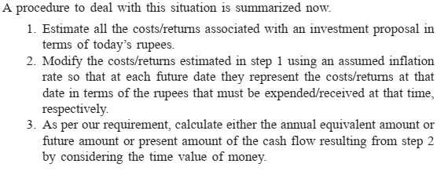
PROCEDURE TO ADJUST INFLATION

Slide 21
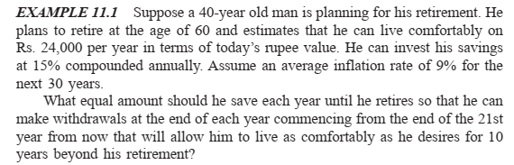
Inflation Adjustment

Slide 22
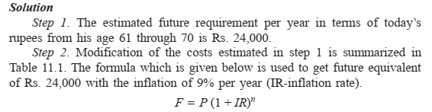
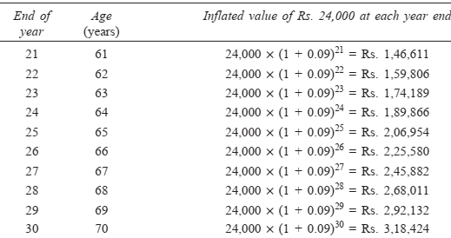

Slide 23
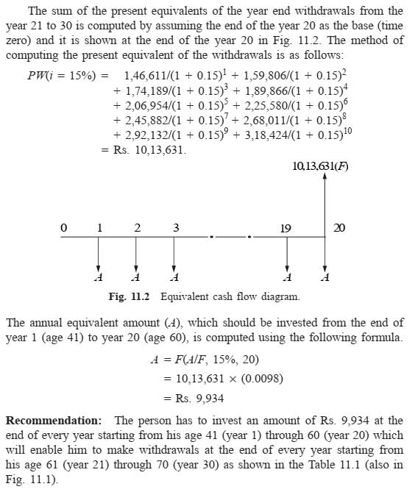

Slide 24
Example
Suppose a 40-year old man is planning for his retirement. He plans to retire at the age of 60 and estimates that he can live comfortably on Rs. 40,000 per year in terms of today’s rupee value. Let us assume the average inflation rate for the next 30 years is 7% per year. This is only an assumption. He can invest his savings at 20%, compounded annually.
What equal amount should he save each year until he retires so that he can make withdrawals that will allow him to live as comfortably as he desires for 10 years beyond his retirement?

